Slide 1

Fashion Forward – Regenerating Clothing Image with Different Attributes
CSCI 2470 Project
Juefei Chen
Yurui Zhang
Yang Zheng

Slide 2
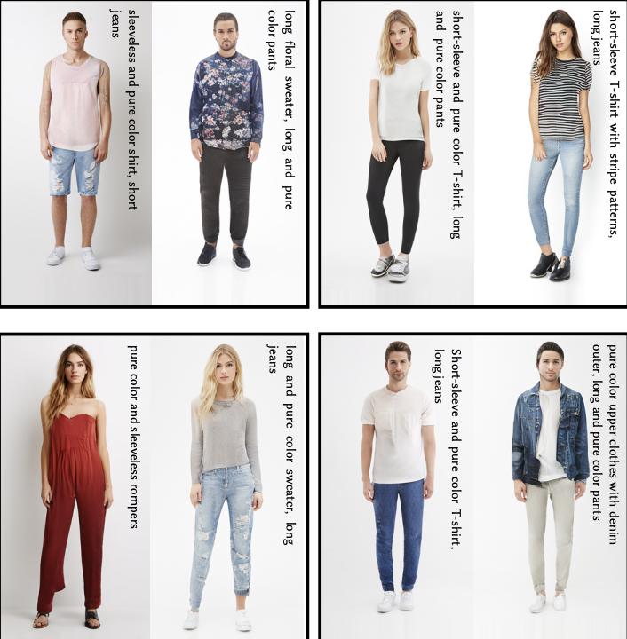
Introduction
Aim: Develop a deep learning model that can transform clothing images into new designs, allowing fashion retailers to offer personalized and customized options to their customers.
Goal: Help retailers to quickly and cost-effectively generate a wide variety of designs, provide customers unique and customized clothing options.

Slide 3
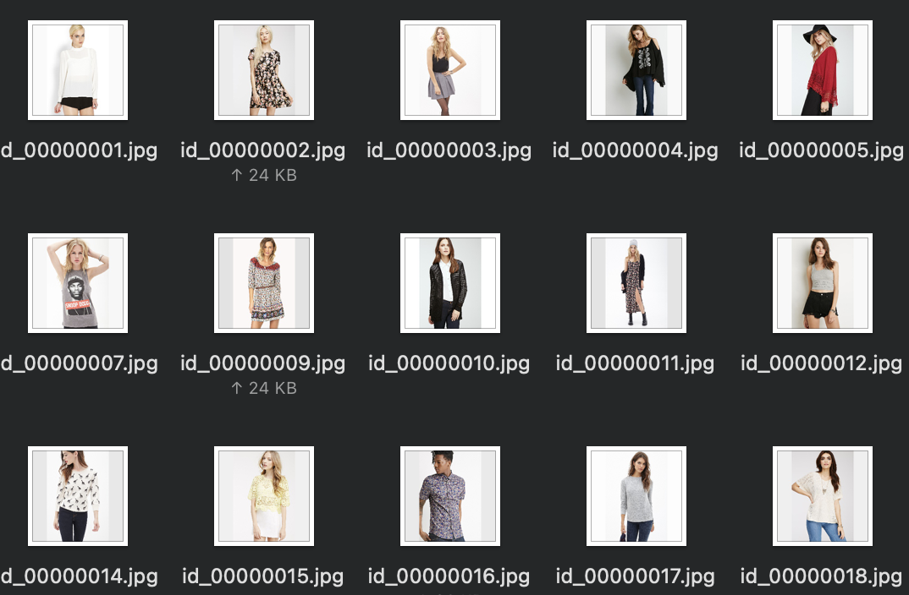
Data
Deepfashion Dataset
Over 8,000 images of clothing items
Includes well-posed shop images and unconstrained consumer photos
Covers 50 different clothing categories and has 759 attributes
Each image is annotated with a bounding box and clothing type

Slide 4
Pre-processing & Splitting
Choose images with front-side view and shrink the image size
Link all chosen images with corresponding attributes
Most attributes are binary except color feature
maps all the unique color tokens as keys to a unique integer value, and then do the embedding
Split the dataset into train set and test set
Ratio 8 : 2

Slide 5
Methodology
CVAE - Conditional Variational Autoencoder
The dataset split into training and test sets
Training process involves passing input images with attributes through the encoder, sampling from the latent distribution, conditioning on desired attributes to generate transformed image
Loss function and hyperparameters will be optimized, and reconstruction error used to measure quality
If issues arise, model's architecture can be modified by adding layers, trying different loss functions or loss function weights, or trying other architectures such as GANs

Slide 6
Loss & Metrics
Model will use a weighted combination of L1 and L2 loss functions for training.
Use reconstruction error as metric to measures how well the model can reconstruct the input.
Base goal is to implement and train the VAE model to generate new images.
Target goal is to improve model quality and accuracy.
Stretch goal is to develop a front-end page for users to generate new images.
Loss = Reconstruction Loss (L1) + Regularization Loss (L2)
= mean squared error + KL loss

Slide 7
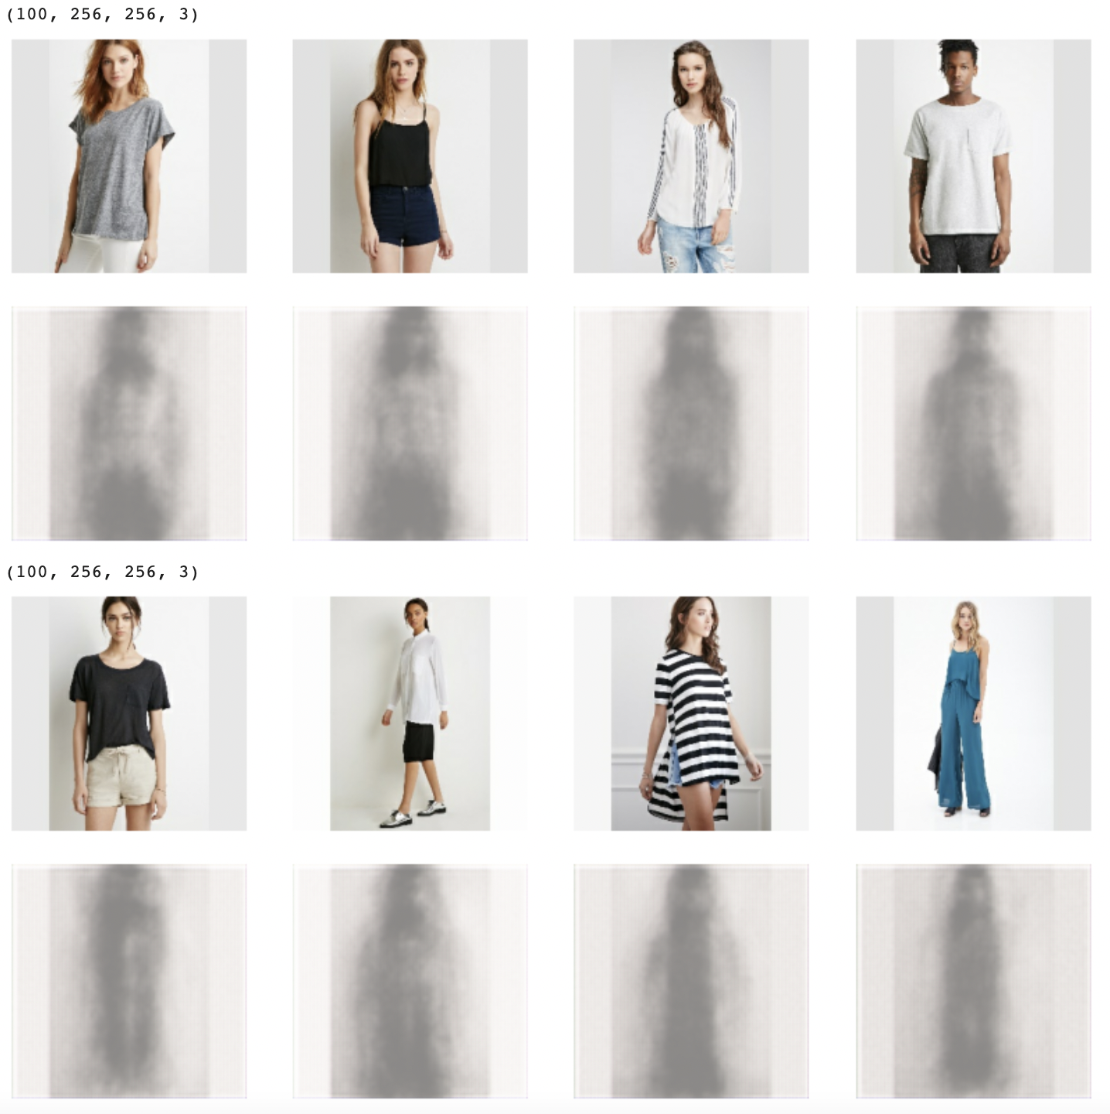
Results
First model

Slide 8
Updated model
U-Net: a CNN architecture for semantic segmentation tasks; also can be used for image processing task
U-Net uses skip connections to retain and recover fine-grained spatial information
We modify the decoder part with additional skip connections
We add the pre-trained VGG16 model as a feature extractor in the encoder part

Slide 9
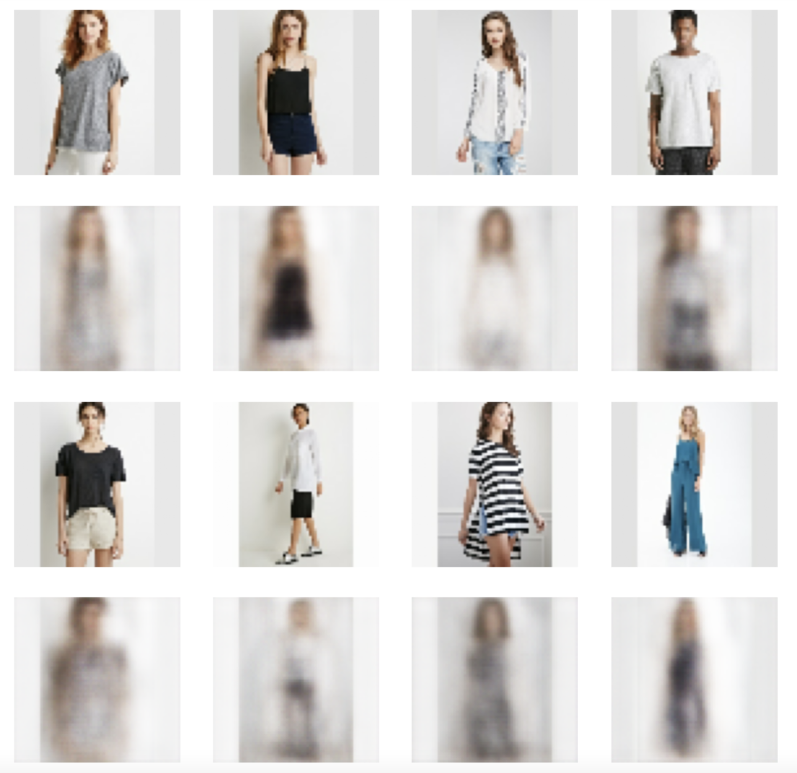
Results - updated model
Reconstruction (10 epochs)

Slide 10
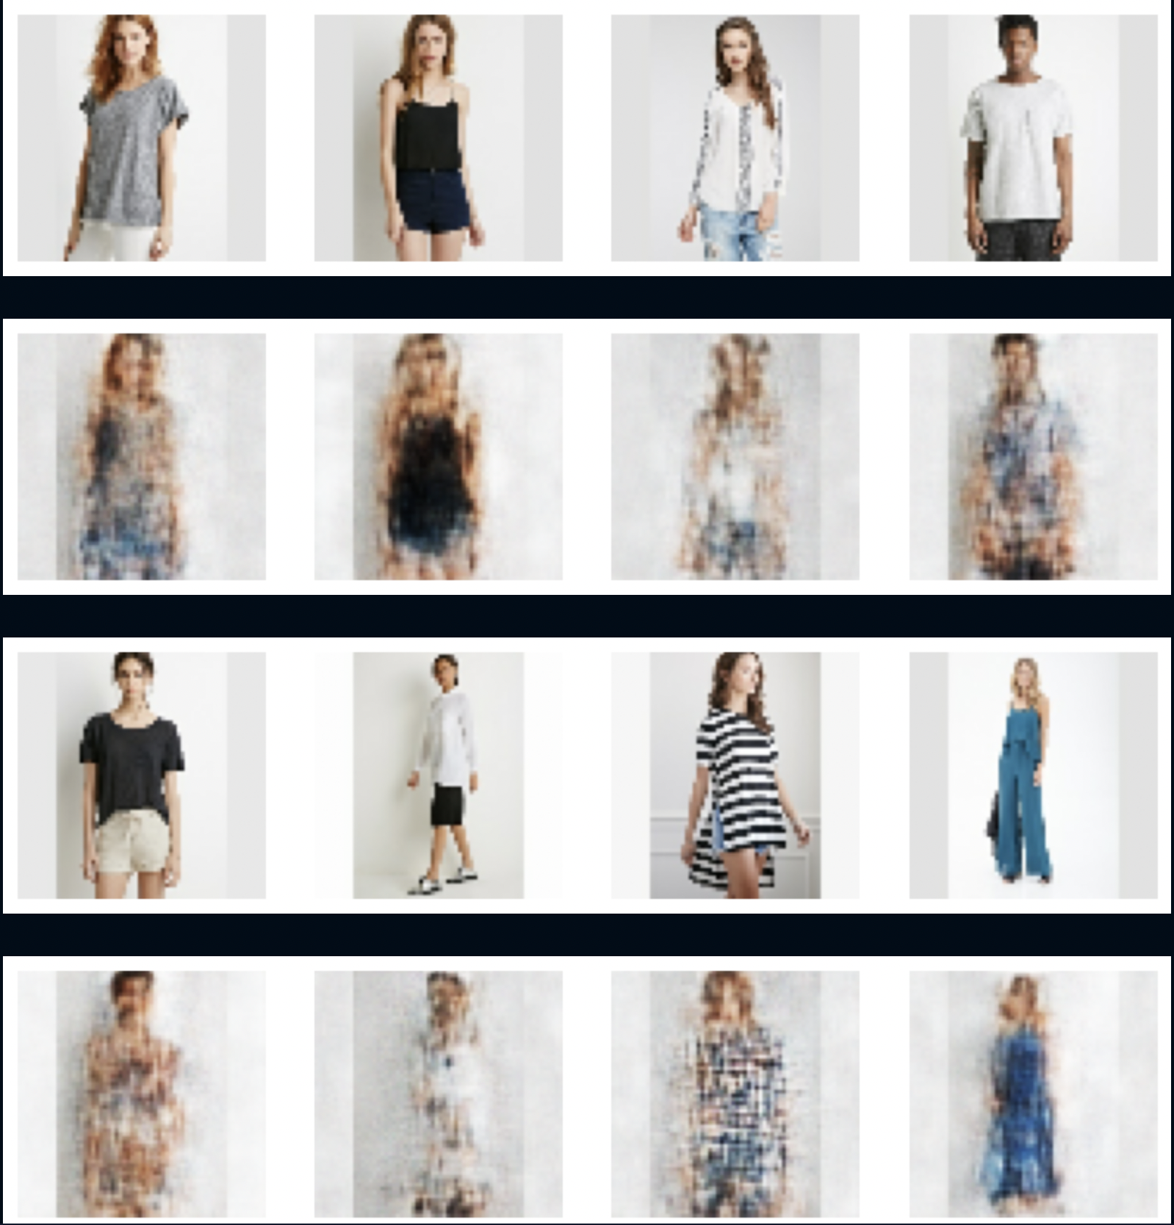
Results - updated model
Reconstruction (200 epochs)

Slide 11
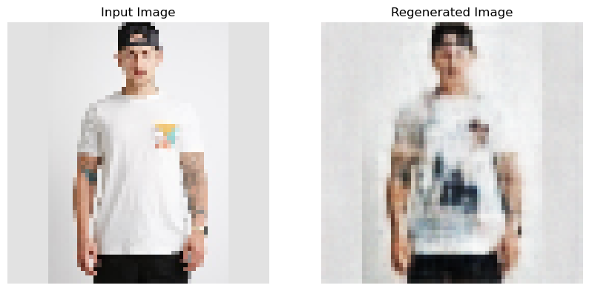
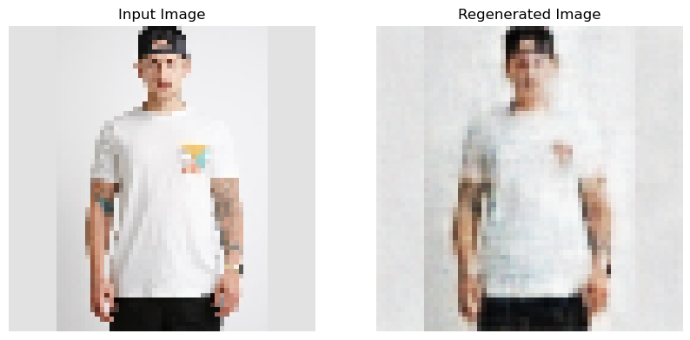
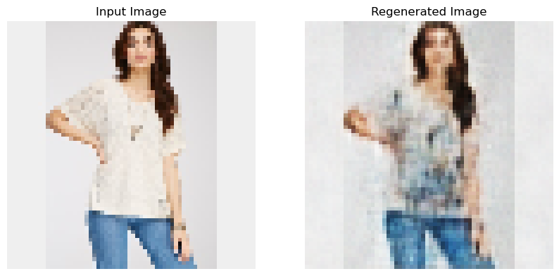
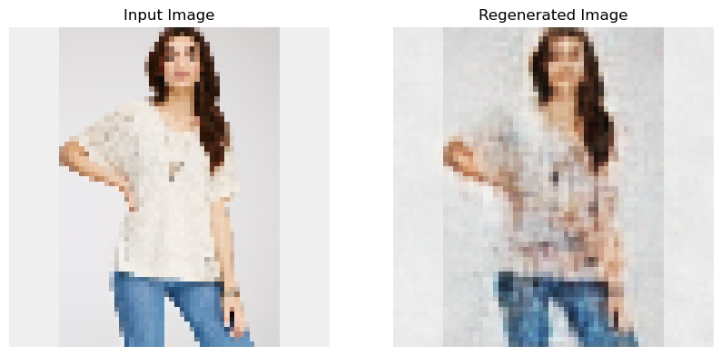
Results - updated model
Regeneration: personalized colors
Original (White) Navy-blue Bright cobalt-red
Original (White) Dark-blue Light-blue

Slide 12
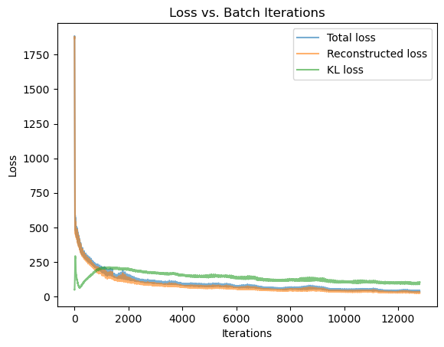
Results - updated model
Loss vs. Batch iterations

Slide 13
Discussion
Lesson learned
Preprocess the data to fit specific goal
Tune the model little by little
Leave enough time to run the model
Limitations
Dataset is still too small
The model have suffered from mode collapse in the very beginning
Large room to improve the result
Future work
Experiment with different architectures to improve the quality of the generated images
Continue to develop model to learn other attributes other than color
Enlarge the dataset

Slide 14
Reference
Z. Liu, P. Luo, S. Qiu, X. Wang and X. Tang, DeepFashion: Powering Robust Clothes Recognition and Retrieval with Rich Annotations, 2016 IEEE Conference on Computer Vision and Pattern Recognition (CVPR), Las Vegas, NV, USA, 2016, pp. 1096-1104, doi: 10.1109/CVPR.2016.124.
Y. Jiang, S. Yang, H. Qiu, W. Wu, C. C. Loy & Z. Liu, (2022). Text2Human: text-driven controllable human image generation. ACM Trans. Graph. 41, 4, Article 162 (July 2022), 11 pages. https://doi.org/10.1145/3528223.3530104
O. Ronneberger, P. Fischer and T. Brox, (2015). U-Net: Convolutional Networks for Biomedical Image Segmentation. ArXiv, abs/1505.04597
Karen Simonyan and Andrew Zisserman. "Very Deep Convolutional Networks for Large-Scale Image Recognition." arXiv preprint arXiv:1409.1556 (2014).

Slide 15
Acknowledgement
We would like to express our deepest appreciation to TAs, Nange Li, Ray Wang, and Vadim Kudlay, for their invaluable support and guidance throughout this project.

Slide 16
Thank You
Q&A?

